Slide 1
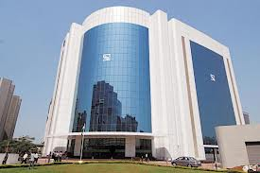
Corporate Actions
[Bonus, Stock Split and Dividends]

Slide 2

DISCLAIMER
The information contained in this material is for only educational and awareness purposes related to securities market and shall be used for non-profitable educational and awareness activities for general public.
No part of this material can be reproduced or copied in any form or by any means or reproduced on any disc, tape, perforate media or other information storage device, etc. without acknowledging the SEBI or Stock Exchanges or Depositories.
SEBI or Stock Exchanges or Depositories shall not be responsible for any damage or loss to any one of any manner, from use of this material.
Every effort has been made to avoid errors or omissions in this material. For recent market developments and initiatives, readers are requested to refer to recent laws, guidelines, directives framed thereunder and other relevant documents, as being declared from time to time. For any suggestions or feedback, you may send the same to visitsebi@sebi.gov.in.
2

Slide 3
Flow of Presentation
Bonus Shares – An Overview
Dividend – An Overview
Stock Split vs Bonus Issue
Dividend – Important Dates
Impact of Bonus Issue/ Stock Split/ Dividend on Price of Share
Recourse in case of Non-Receipt of Bonus Shares/ Dividend
Sample of RTA Details on Company Website
Sample of Investor Complaints Contact in Listed Company
- This presentation may be used with the permission of SEBI and only for non-profit awareness programs.
3

Slide 4
Bonus Issue - Overview
Issued in a certain proportion only to the existing shareholders.
Eg : 2:1 bonus shares → If you already own 1 share, you get 2 additional new shares.
→ Total holding of shares is now 3 shares instead of 1 share.
No need to pay any money for these shares.
Who pays for the Bonus shares?
  Cash lying in free reserves and surplus of the Company → Moved to Capital.
  Addition of fresh Capital → fresh equity shares are issued to eligible equity shareholders in a specific ratio.
New shares are issued at the existing Face Value of equity shares of the Company.
Face value remains the same post bonus issue.
- This presentation may be used with the permission of SEBI and only for non-profit awareness programs.
4

Slide 5
Effect of Bonus Issue
Effects of Bonus Issue
Increases number of outstanding equity shares
Reduces share price in proportion to number of bonus shares issued.
Reduces free reserves and surplus of the Company.
Creates implicit value per equity share
Increases liquidity in equity shares on the stock exchanges
Reduces per share ratios (for e.g: EPS, Book Value per share, etc.)
- This presentation may be used with the permission of SEBI and only for non-profit awareness programs.
5

Slide 6
Dividend - Overview
Dividend = Distribution of certain portion of Company’s profits to its shareholders.
Dividend pay out ratio = Dividends Paid
Net Earnings
Net-Profits which aren’t distributed as Dividend =
Put in the Free reserves and surplus of the Company.
Interim dividend : Given during the year is authorised by the Board of the Company.
Final dividend : Recommended by Board of the Company.
Approved by its shareholders in the Annual General Meeting (AGM).
- This presentation may be used with the permission of SEBI and only for non-profit awareness programs.
6

Slide 7
Stock Split vs Bonus Shares
Basis | Stock Split | Bonus Issue
Meaning | Already owned shares split into smaller shares. | Free additional shares given to existing shareholders based on no. of shares owned.
Reason | To improve Liquidity by breaking it into smaller size. | To distribute gains of accumulated earnings without paying cash to the shareholders.
Face Value (FV) | Reduces in proportion of split ratio. | Remains same.
Share Capital & Reserves | No impact. | Reserves reduced. Money moved to Share capital as new shares are issued.
Impact on future Dividend | Reduces in proportion to split ratio. | Remains same.
Beneficiaries | Shareholders (as on Record Date). | Shareholders (as on Record Date).
Example | Stock Split = 1:10 → Every already owned share is split into 10 new shares of new FV of 1/10 of original FV. | Bonus issue = 2:1 Shareholder gets 2 free shares for every 1 share already owned. So finally he has 1+2 =3 shares of same FV as before.
- This presentation may be used with the permission of SEBI and only for non-profit awareness programs.
7

Slide 8
Dividend – Important Dates
DATE | MEANING
Declaration Date | Date of approval of Dividend Rate (per share) by Board of Directors of Company.
Record Date | Proposed by Board of Directors to determine name of the eligible shareholders for dividend. All eligible shareholders with their names in the list at the end of Record Date will be eligible to receive dividends. Minimum gap of 5 clear working days needed between Declaration Date and Record Date. Shares credited in Demat account two days after the actual purchase on Stock Exchange platform. To be eligible for receiving dividend: Investors to have shares in the Demat account by record date.
- This presentation may be used with the permission of SEBI and only for non-profit awareness programs.
8

Slide 9
Dividend – Important Dates
DATE | MEANING
Cum Dividend Date | Last Date to buy shares in order to be eligible to receive dividend. One-day prior to Ex-Dividend Date.
Ex-Dividend Date | On this day the price of the equity share of the Company gets adjusted for the dividend pay out. Stock exchanges determine and notify this date. One working day prior to the Record Date
Payment Date/ Issue Date | Payment of dividend to be completed within 30 days of its approval. Eligible shareholders receive the dividend amount before this date.
- This presentation may be used with the permission of SEBI and only for non-profit awareness programs.
9

Slide 10
Bonus Issue: Impact on Price of Share
Post Bonus Market Price Pre Bonus Market Price of Share
of Equity Share = Post Bonus Number of Shares (Adjustment Factor)
where
Bonus Ratio (A:B) {A bonus shares for every B Shares held}
Adjustment Factor = (A+B) / B
Eg: Market Price of One Equity Share (a) = Rs.15/-
Bonus Ratio (b) = 2 : 1
Adjustment Factor (c) = 3 {(2+1)/1}
Post Split Market Price (a/c, i.e. 15/3) = Rs.5/- per share
- This presentation may be used with the permission of SEBI and only for non-profit awareness programs.
10

Slide 11
Stock Split: Impact on Price of Share
Post Split Market Price Pre Split Market Price of Share
of Equity Share = Resultant Final Number of Shares (Adjustment Factor)
where
Split Ratio (A:B) {A shares for every B Shares held}
Adjustment Factor = A/B
Eg: Market Price of One Equity Share (a) = Rs.15/-
Stock Split (b) = From Face Value of Rs.10/- to Rs.5/-
Split Ratio (10/5, from “b” above) = 2 : 1
Adjustment Factor (c) = 2
Post Split Market Price (a/c, i.e. 15/2) = Rs.7.50/- per share
- This presentation may be used with the permission of SEBI and only for non-profit awareness programs.
11

Slide 12
Dividend: Impact on Price of Share
Payment of Dividend
Reduces of Market Price of Share by dividend (w.e.f ex-record date)
Post Dividend Market Price of Share = Pre Dividend Price – Dividend Amount
Eg: Market Price of One Equity Share (a) = Rs.10/-
Dividend declared per Share (b) = Rs.2/-
Ex-Dividend Market Price per equity share (a – b) = Rs.8/- (10-2)
- This presentation may be used with the permission of SEBI and only for non-profit awareness programs.
12

Slide 13
Recourse in case of Non-Receipt of Bonus Shares/ Dividends
Issue with Non-receipt of Bonus Shares/ Dividend → Immediately contact RTA and Company.
Important Contact Details:
Non-Satisfactory Resolution by RTA -> File a complaint against RTA with SEBI on:
  SEBI SCORES website/ Mobile App (on Android and iOS platform).
 | CONTACT DETAILS
RTA | Company Website. SEBI website on link: https://www.sebi.gov.in/sebiweb/other/OtherAction.do?doRecognisedFpi=yes&intmId=10.
Designated Person in Company | Investor Relations/ Investor Services Section of Company Website.
- This presentation may be used with the permission of SEBI and only for non-profit awareness programs.
13

Slide 14
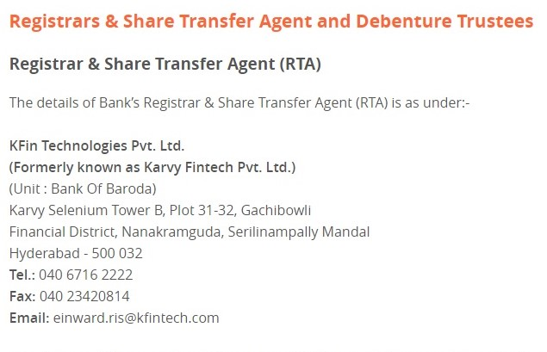
Sample of RTA Details on Company Website
- This presentation may be used with the permission of SEBI and only for non-profit awareness programs.
14

Slide 15
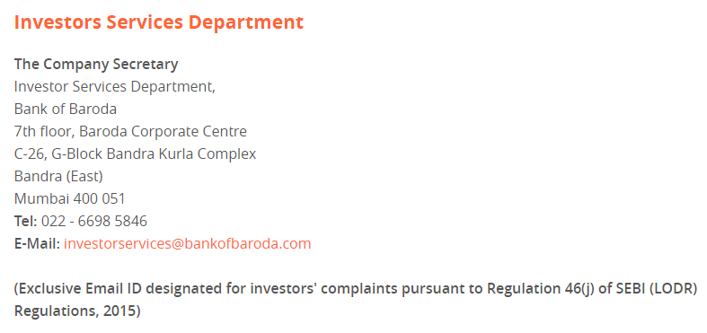
Sample of Investor Complaints Contact in Listed Company
- This presentation may be used with the permission of SEBI and only for non-profit awareness programs.
15

Slide 16
Thank You
- This presentation may be used with the permission of SEBI and only for non-profit awareness programs.
16

